Slide 1
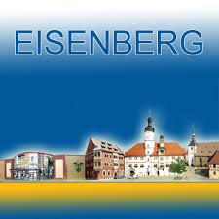
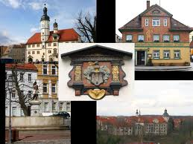
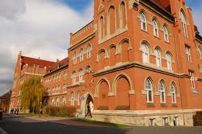
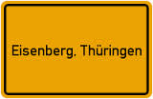
Presentation of Eisenberg

Slide 2
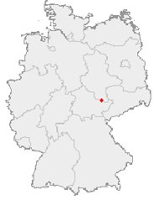
„The town around the school”
„The town around the school” is Eisenberg
Eisenberg is a nice town where circa 12.000 inhabitants live.
It is situated in the district of Thuringia and takes in around 25 km². The town’s history already began in the Stone Age, but Eisenberg got its municipal law in 1274.
Eisenberg
Black Moor
Schlosskirche
Mühltal
Famous people
Thuringian Dishes
Our School
Time table
Extracurricular Activities
map of Germany:
the red point shows the position of Eisenberg

Slide 3
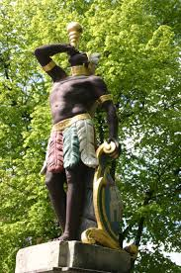
„The town around the school”
At the marketplace of Eisenberg can be seen a fountain with a human figure standing on it, it’s a black Moor.
He symbolizes the connection to Eisenberg’s legend which tells that this black Moor was a butler. He should be to blame for the miss of the earl’s woman’s necklace.
Because of that he should be killed but some moments before this should be done the countess found her jewellery again and could avoid the butler’s killing. He got his freedom and didn’t have to live there any longer.
Eisenberg
Black Moor
Schlosskirche
Mühltal
Famous people
Thuringian Dishes
Our School
Time table
Extracurricular Activities

Slide 4
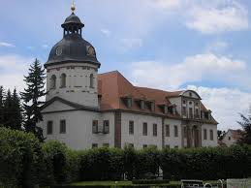
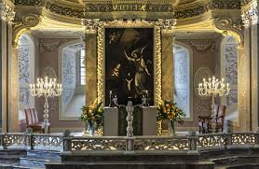
„The town around the school”
Otto der Reiche let build a castle in 1174.
After many years and much destruction it got a church and was rebuilt in 1676 by the duke Christian.
So there was one of the most beautiful baroques churches of Thuringia. The building is a typical protestant one and inside there are high decorated walls and galleries.
Eisenberg
Black Moor
Schlosskirche
Mühltal
Famous people
Thuringian Dishes
Our School
Time table
Extracurricular Activities

Slide 5
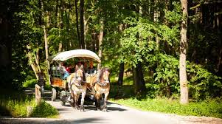
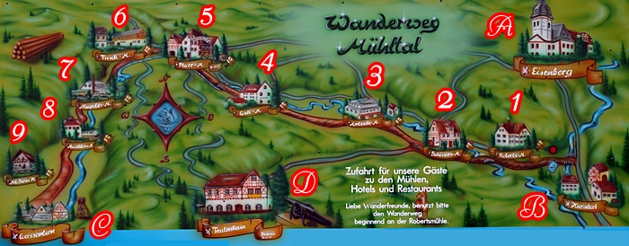
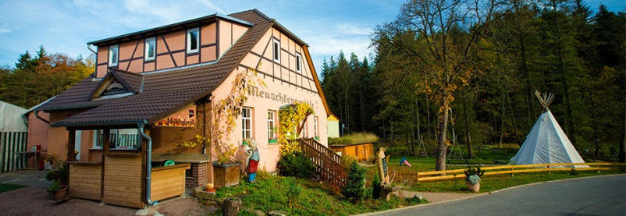
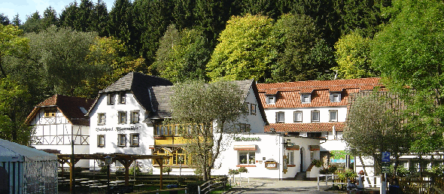
„The town around the school”
For those who want to relax, they can discover Eisenberg’s Mühltal.
In this valley of mills the great smell of the forest can be enjoyed and one of the many nice mills can be entered to have a break.
Eisenberg
Black Moor
Schlosskirche
Mühltal
Famous people
Thuringian Dishes
Our School
Time table
Extracurricular Activities
some of the mills in the Mühltal

Slide 6
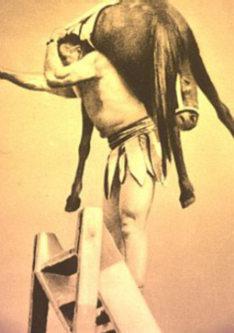
Famous people of Eisenberg
Milo Barus:
he was the strongest man of the world.
Barus was able to carry horses, to lift elephants and to tear books.
Eisenberg
Black Moor
Schlosskirche
Mühltal
Famous people
Thuringian Dishes
Our School
Time table
Extracurricular Activities

Slide 7
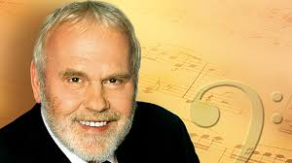
Famous people of Eisenberg
Another man who is famous for Eisenberg and also well known is Gunther Emmerlich.
He belongs to the world of opera. Since twenty years he is part of the Semper Opera House.
Eisenberg
Black Moor
Schlosskirche
Mühltal
Famous people
Thuringian Dishes
Our School
Time table
Extracurricular Activities

Slide 8
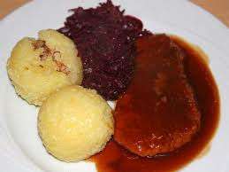
Thuringian Dishes
Eisenberg
Black Moor
Schlosskirche
Mühltal
Famous people
Thuringian Dishes
Our School
Time table
Extracurricular Activities
Thuringian dumplings (made of potatoes) and roasted pork or beef is a quite common meal on Sundays.

Slide 9
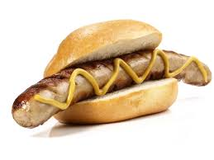
Thuringian Dishes
Eisenberg
Black Moor
Schlosskirche
Mühltal
Famous people
Thuringian Dishes
Our School
Time table
Extracurricular Activities
Also famous is our "Thüringer Bratwurst". It is a grilled sausage mostly eaten with mustard in a roll.

Slide 10
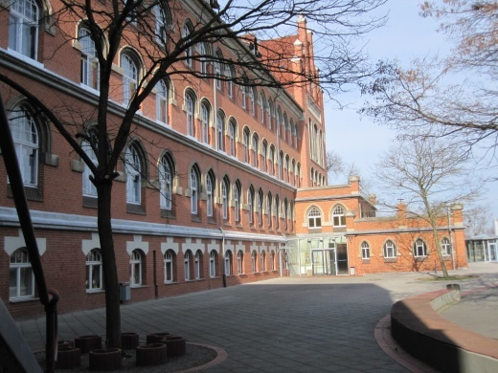
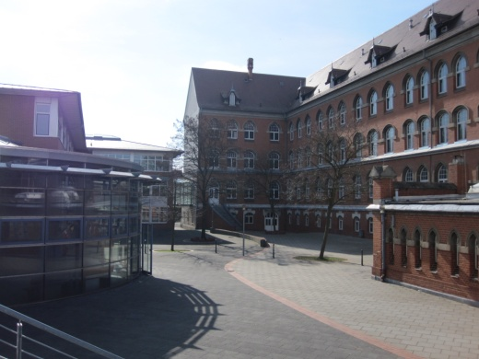
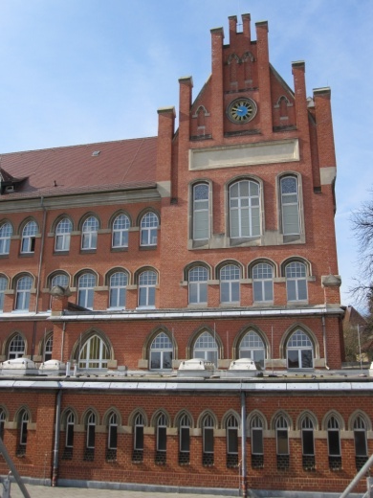
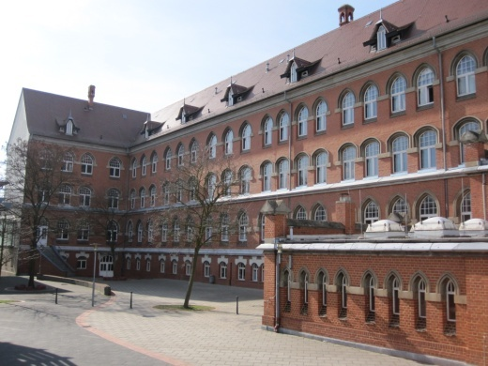
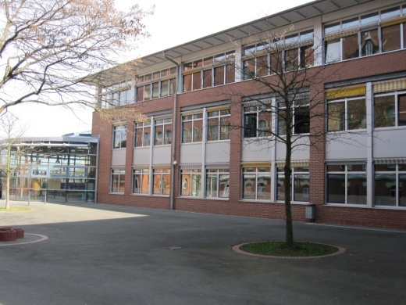
Friedrich- Schiller- Gymnasium
Welcome to our Friedrich- Schiller- Gymnasium in Eisenberg!
When you come to our school you will have a great experience.
Eisenberg
Black Moor
Schlosskirche
Mühltal
Famous people
Thuringian Dishes
Our School
Time table
Extracurricular Activities

Slide 11
Friedrich- Schiller- Gymnasium
Every morning we start at 7.40 am and finish at 1.05 pm or 3.30 pm it depends on the day.
In that time we have different subjects with different teachers.
Between the lessons we have breaks from 10 up to 30 minutes, this depends on the time of the day. One lesson lasts 45 minutes.
After nearly every lesson we have to change the rooms because for all the subjects we have different floors or better to say things like biology, chemistry are one floor but German and History are in another part of the school building.
At our school are about 600 pupils.
Of course learning is the most important thing and so you also have to pass different examinations.
In the 10th class you have to do one that is necessary to go on at school and in the 12th class you pass the A- level.
Eisenberg
Black Moor
Schlosskirche
Mühltal
Famous people
Thuringian Dishes
Our School
Time table
Extracurricular Activities

Slide 12
Friedrich- Schiller- Gymnasium
Our school offers many different subjects to choose from. From 5th to 10th grade you are required to take almost all 16 subjects including:
German
Mathematics
English
Chemistry
Physics
History
Art
Music
Geography
Economics & Law
Social Studies
Ethics or Religious Education
Biology
French/Latin/Russian
PE
Eisenberg
Black Moor
Schlosskirche
Mühltal
Famous people
Thuringian Dishes
Our School
Time table
Extracurricular Activities

Slide 13
Friedrich- Schiller- Gymnasium
Additional subjects are Astronomy and Information Technology Basics.
For the last two years of school (11th and 12th grade), students are able to choose 5 requirements and 6 electives for their A-levels.
Eisenberg
Black Moor
Schlosskirche
Mühltal
Famous people
Thuringian Dishes
Our School
Time table
Extracurricular Activities

Slide 14
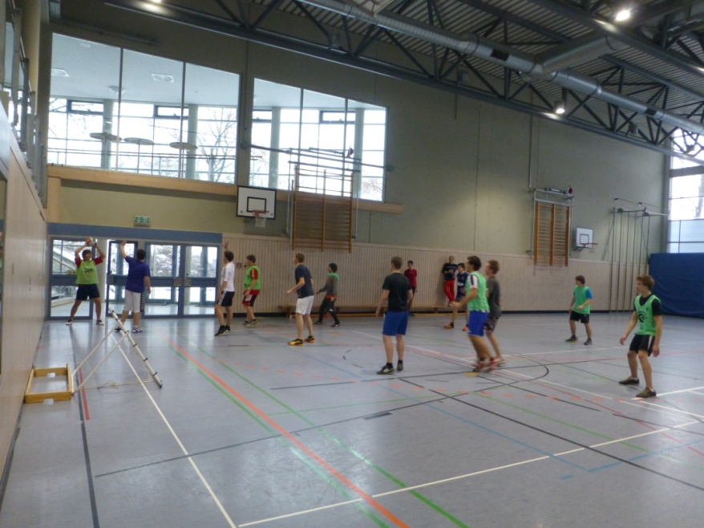
Friedrich- Schiller- Gymnasium
Extracurricular Activities
In the afternoons you are able to join various free time activities and clubs at school.
There are different Sports Clubs such as:
rock climbing
Volleyball
Ping-Pong
Track & Field
Eisenberg
Black Moor
Schlosskirche
Mühltal
Famous people
Thuringian Dishes
Our School
Time table
Extracurricular Activities

Slide 15
Friedrich- Schiller- Gymnasium
Other Activities are:
Spanish
Russian
Most extracurricular activities take place on Thursday afternoons as well as on the other days of the week.
Eisenberg
Black Moor
Schlosskirche
Mühltal
Famous people
Thuringian Dishes
Our School
Time table
Extracurricular Activities

Slide 16
Haftungsausschluss
Dieses Projekt wurde mit Unterstützung der Europäischen Kommission finanziert. Die Verantwortung für den Inhalt dieser Veröffentlichung (Mitteilung) trägt allein der Verfasser; die Kommission haftet nicht für die weitere Verwendung der darin enthaltenen Angaben.

